Slide 1



REPUBLIC OF CAMEROON
Peace - Work - Fatherland
---------------
REPUBLIQUE DU CAMEROUN
Paix - Travail - Patrie
---------------
The HPSF at the core of the
downstream petroleum sector
Regulate to secure the supply of
domestic market with petroleum products
Presented by Mr WAZIRI HASSAN OUMATE,
Director of Follow-up, Studies and Oil Statistics
Under the supervision of Mr OKIE Johnson NDOH,
General Manager of the HPSF;

Slide 2
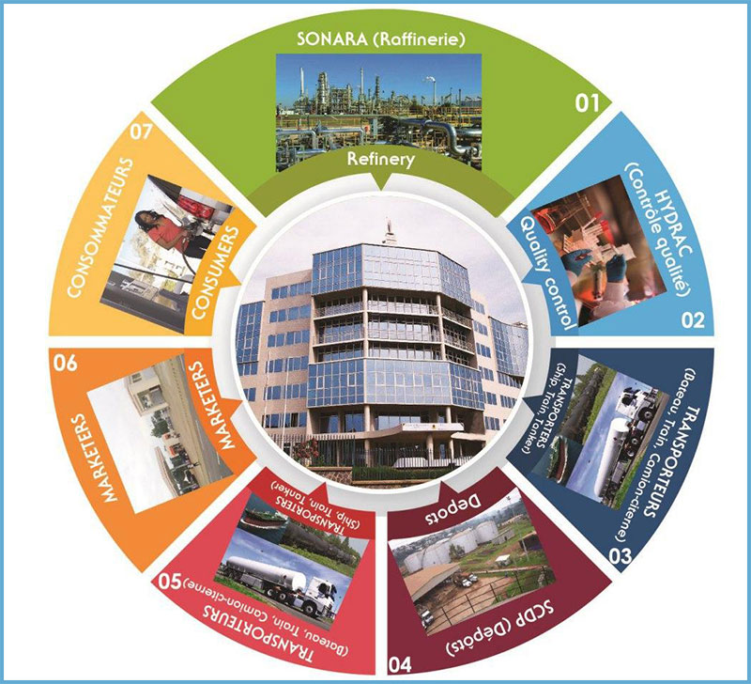

Slide 3
PLAN
INTRODUCTION
I- CREATION OF THE HPSF
A- History of creation and reorganisations
B- MISSION OF THE HPSF
II- ECONOMIC ROLE OF THE HPSF
A- Before liberalisation
B- After liberalisation
III- DOWNSTREAM PETROLEUM SECTOR
A- Institutional framework
B- regulatory framework
C- Actors of the downstream petroleum sector
REFORM OF THE DOWNSTREAM PETROLEUM SECTOR
A- Pre-reform context
B- Objectives of the reform
C- Impacts of the reform on the downstream petroleum sector

Slide 4
PLAN
V- SUPPLY MECHANISMS
A- General information on supply
B- Sources of supply
C- Procurement procedures
D- Supply channel
E- Storage
F- Transport
G- Distribution
H- Quality control and fight against fraud
I- Role of regional services
VI- CHALLENGES, CONSTRAINTS AND PROSPECTS
A- Product accessibility
B- Storage capacity
C- Transport and packaging logistics
D- Improvement of production capacity
CONCLUSION

Slide 5
INTRODUCTION

Slide 6
INTRODUCTION
Oil activity in Cameroon is based on two sectors: the upstream and downstream oil sectors.
The upstream sector consists of research, exploration and production;
the downstream sector comprises refining, storage, transport, distribution and quality control of finished or semi-finished petroleum products.
While the upstream sector was harmonised through the implementation of a petroleum code and a gas code, the downstream sector on its part is subject to a regulatory system (decrees and orders), particularly Decree No. 2000/935/PM of 13 November 2000 setting conditions for the conduct of downstream oil sector activities and its implementing decrees.

Slide 7
SECTION I:
THE SUPERVISORY BODIES OF THE HPSF

Slide 8
I- CREATION OF THE HPSF
A.- HISTORY
Created by decree No. 74/458 of 10 May 1974, after the first oil shock, to protect the national economy from the fluctuations of hydrocarbon prices on the international market;
Reorganised for the first time by decree No. 98/165 of 26 August 1998, this reorganisation reflects the government's desire to modernise its management and increase the efficiency of its services.
Henceforth, the HPSF:
Is endowed with a legal personality instead of a civil one;
can set up branches;
is now managed by a Board of Directors rather than a Management Committee;
is headed by a General Manager who is different from the Director of Prices and a Deputy General Manager, both of whom are appointed by Decree of the President of the Republic.

Slide 9
I- CREATION OF THE HPSF
A.- HISTORY (continuation and end)
Reorganised a second time by Decree No. 2019/032 of 24 January 2019.
The HPSF is a special public establishment with legal personality and financial autonomy.
Its mission was expanded to ensure the regulation of supplies in addition to the regulation of petroleum product prices, and its operational management body is now a General Management and no longer a Directorate.

Slide 10
I- CREATION OF THE HPSF
C. THE MISSION OF THE HPSF
The mission of the HPSF is to regulate the prices and the supply of petroleum products nationwide by any mechanism provided for by the laws and regulations in force.
As such, it is responsible in particular for:
the total or partial coverage of petroleum products price increases, within the limits of its financial resources;
all operations likely to stabilise the said prices in accordance with the laws and regulations in force;
all mechanisms and operations aimed at improving the supply of petroleum products nationwide, in conjunction with the Monitoring Committee for the Supply of Petroleum Products to the domestic market.

Slide 11
I- CREATION OF THE HPSF
C. THE MISSION OF THE HPSF
(Continuation and end)
The HPSF is also involved in all operations that ensure healthy competition between economic operators of the sector;
it guarantees consumer protection with regard to petroleum products;
It contributes, where necessary, to all operations aimed at controlling national energy policy.
The aim of all this is to fight against inflation.

Slide 12
SECTION II:
II- ECONOMIC ROLE
OF THE HPSF

Slide 13
II- ECONOMIC ROLE OF THE HPSF
A- ECONOMIC ROLE OF THE HPSF BEFORE LIBERALISATION
Responding to a government policy at the time when the State was an investor, the HPSF served as a secular arm for the implementation of some projects:
Oil sector (SONARA, SCDP, CNIC);
Hotel sector (SOHLI, CHC, SHNC);
Agro-industrial sector (SODECOTON);
Social sector (rehabilitation of the urban road network in Yaounde) - Nkolndongo, Essos and Nkoleton roads; the removal of household waste in Yaounde; participation in the financing of the construction works of the Mokolo and Mfoundi food markets in Yaounde; participation in the financing of the construction works of the Mokolo dam in the Far North).

Slide 14
II- ECONOMIC ROLE OF THE HPSF
B- ECONOMIC ROLE OF THE HPSF AFTER LIBERALISATION
(CONTINUATION)
With the liberalisation of the downstream oil sector between 1995 and 2002, the HPSF ensures:
The regular supply of petroleum products to the country by;
Modulation of supply through imports;
Payment of additional transport costs (road transfer) in case of failure of the traditional logistic scheme;
Intervention on the access roads (detours on the Kekem route, bridge over the Mungo river).

Slide 15
II- ECONOMIC ROLE OF THE HPSF
B- ECONOMIC ROLE OF THE HPSF AFTER LIBERALISATION
(CONTINUATION)
The HPSF also ensures healthy competition between economic operators of the sector through:
fair access for consumers to petroleum products;
equal access for distributors to the storage capacity;
the control and monitoring of monopoly areas in order to avoid the abuses of a dominant position (application of the fair price);
the construction of pilot service stations in unserved and unprofitable areas exploited by marketers;

Slide 16
II- ECONOMIC ROLE OF THE HPSF
B- ECONOMIC ROLE OF THE HPSF AFTER LIBERALISATION
(Continuation and end)
The construction of the Maroua LPG Filler Centre with an initial capacity of 105 MT inaugurated in 2006 with the aim of protecting the environment and satisfying the growing demand in the region with the creation of the University of Maroua and the Sahel Institute and the Bertoua LPG Filler Centre with a capacity of 100 MT inaugurated in 2015;
The construction of the HPSF Head Office building to improve working conditions and ensure the company's visibility.

Slide 17
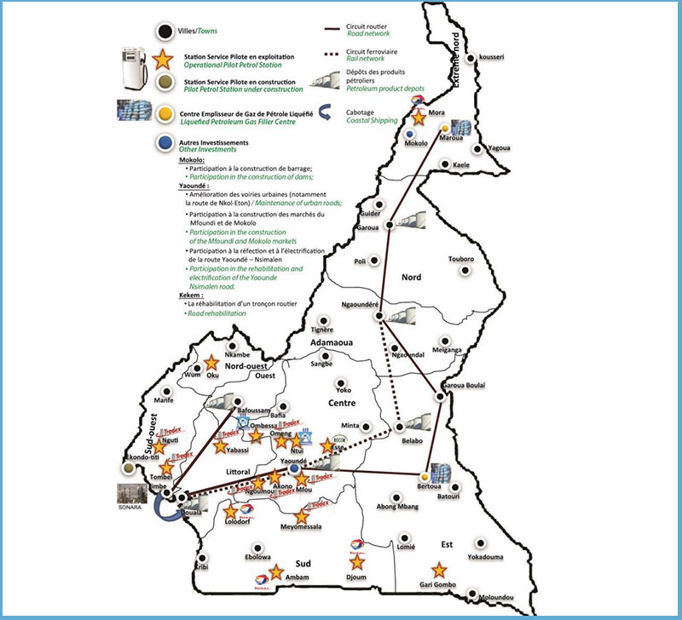
THE ACHIEVEMENTS OF THE HPSF

Slide 18
SECTION III
THE DOWNSTREAM
PETROLEUM SECTOR

Slide 19
III- DOWNSTREAM PETROLEUM SECTOR
The practise of an activity in the downstream oil sector is governed by Decree no. 2000/935/PM of 13 November 2000 to lay down conditions for carrying out activities in the downstream petroleum sector and its application texts.
The downstream oil sector is centred on the following major activities:
- hydrocarbon refining ;
- storage;
- transport;
- distribution;
- imports;
- exports; quality and quantity control of petroleum products.
NB :
Entry into the downstream oil sector is subject to authorisation.
Authorisations are issued by MINEE after the approval of the National Committee for Oil Products (CNPP).

Slide 20
III- DOWNSTREAM PETROLEUM SECTOR
A- INSTITUTIONAL FRAMEWORK OF THE DOWNSTREAM PETROLEUM SECTOR
It is the set of institutions that define national policy, strategic orientations, financial, customs and fiscal policy, price policy, product quality and ensures the regulation of the sector.
These are:
The Presidency of the republic: Responsible for guiding national policy and ensuring the smooth functioning of the country's affairs;
The Prime Minister's Office: Coordinating government activities ;
MINCOMMERCE Responsible for the development and implementation of pricing policy and metrology ;
MINFI Responsible for the development and implementation of financial, customs and tax policy;
MINEE Responsible for the development of the country's energy policy and its implementation
MINMIDT: Responsible for the elaboration of industrial development policy;
HPSF: Responsible for price structure development and regulation of supplies.

Slide 21
III- DOWNSTREAM PETROLEUM SECTOR
A- INSTITUTIONAL FRAMEWORK OF THE DOWNSTREAM PETROLEUM SECTOR
The Constitution of the Republic of Cameroon.
Laws and ordinances :
Order No. 94/004 of 16 February 1994 relating to the taxation of petroleum products;
Law n°64-LF- 13 of 13 November 1964 on the protection of public health;
Law n°96/12 of 05 August 1996 on the framework law on environmental management;
Law n° 98/015 of 14 July 1998 relating to establishments classified as dangerous, unhealthy or obnoxious;
Law n°98/020 of 24 december 1998 to lay down regulations governing compressed gas and steam-powered equipment;
Law No. 99/013 of 22 December 1999 on the petroleum code;

Slide 22
III- DOWNSTREAM PETROLEUM SECTOR
A- INSTITUTIONAL FRAMEWORK OF THE DOWNSTREAM PETROLEUM SECTOR
(CONTINUATION)
Law No. 2015/018 of 21 December 2015 regulating the commercial activity in Cameroon;
Law No. 99/008 of 25 April 2019 on the petroleum code;
Decrees :
Decree n° 77/528 of 23 December 1977 regulating the storage and distribution of petroleum products;
Decree n° 95/135/PM of 03 March 1995 modifying certain provisions of Decree 77/528 of 23 December 1977 regulating the storage and distribution of petroleum products;
Decree n° 95/135/PM of 03 March 1995 modifying certain provisions of Decree 77/528 of 23 December 1977 regulating the storage and distribution of petroleum products;

Slide 23
III- DOWNSTREAM PETROLEUM SECTOR
A- INSTITUTIONAL FRAMEWORK OF THE DOWNSTREAM PETROLEUM SECTOR
(CONTINUATION)
Decree no. 2000/465/PM of 30 June 2000 setting the modalities of application of Law No. 99/013 of 22 December 1999 on the petroleum code in Cameroon;
Decree no.2000/935/PM of 13 November 2000 setting the conditions for carrying out activities in the downstream oil sector and its subsequent amendments;
Decree no.2002/2044/PM of 20 November 2002 establishing a Committee for the Coordination of the Fight against fraudulent use of petroleum products, amended and supplemented by Decree n°2009/1593/PM of 22 July 2009;
Decree no. 2010/3032/PM of 08 November 2010 on the chemical labelling of petroleum products in Cameroon.
Decree no. 2013/171/PM of 14 February 2013 setting the terms and conditions for carrying out environmental and social impact studies;
Decree no. 2013/172/PM of 14 February 2013 setting the conditions for carrying out the environmental and social audit;

Slide 24
III- DOWNSTREAM PETROLEUM SECTOR
A- REGULATORY FRAMEWORK OF THE DOWNSTREAM PETROLEUM SECTOR
(CONTINUATION)
Decree no. 2014/2379/PM of 20 August 2014 laying down modalities for coordinating inspections of establishments classified as dangerous, unhealthy or obnoxious.
Orders
Order no. 24/PM/CAB of 13 February 2008 laying down the procedure for supplying the domestic market with petroleum products, amended and supplemented by Order no. 125/CAB/PM of 10 September 2012;
Order no. 006/PM of 12 January 2009 setting the terms and conditions, technical and safety rules relating to the establishment, development and operation of storage depots and filler centres for liquefied petroleum gas (LPG);
Order no. 047/CAB/PM of 26 May 2015 laying down the conditions of handling, storage and transport of liquefied petroleum gas (LPG) cylinders on pallets in Cameroon;
The joint MINEFI-MINDIC Order no. 00126 of 30 June 1998 defining certain conditions and modalities for the imports of petroleum products;

Slide 25
III- DOWNSTREAM PETROLEUM SECTOR
A- REGULATORY FRAMEWORK OF THE DOWNSTREAM PETROLEUM SECTOR
(CONTINUATION)
Joint Order no. 0046/98/MINMEE/MINDIC of 03 July 1998 to approve the specifications of petroleum products sold in Cameroon;
Joint Order no. 025/MINMEE/MINDIC of 05 October 2001 laying down the level of security intended to cover the commitments of downstream oil sector operators and its subsequent amendments;
Joint Order n°00012/2004/MINEE/MINEFI of 19 May 2004 modifying and approving certain specifications of petrol manufactured, imported and released for consumption in Cameroon;
Joint Order No. 002166 MINMIDT/MINEE of 20 June 2012 making the standard for commercial butane gas cylinders NC 02 mandatory: 2000-08
Order no. 00000488/MINEE/MINCOMMERCE of 10 October 2012 modifying and supplementing certain provisions of Order no. 07/MINCOMMERCE/MINEE of 28 March 2008 on the organisation and functioning of the Follow-up Committee of Oil Products Supply;
Order no. 00000489/MINEE/MINCOMMERCE of 10 October 2012 laying down the specific procedure for the supply of petroleum products to the northern part of Cameroon from the Djermaya-Chad refinery;

Slide 26
III- DOWNSTREAM PETROLEUM SECTOR
A- REGULATORY FRAMEWORK OF THE DOWNSTREAM PETROLEUM SECTOR
(CONTINUATION)
Joint Order no. 0002360/MINEE/MINMIDT of 1st April 2015 modifying and approving certain specifications of petroleum products manufactured, imported and released for consumption in Cameroon;
Order No. 016/MINMEE of 13 July 1995 laying down the conditions and procedures for the control of petroleum products;
Order no. 01/97/MINMEE of 05 January 1998 laying down the terms and conditions for the setting up of service stations;
Order no. 009/MINT/DTT of 23 February 1998 regulating the transport of dangerous goods;
Order No. 022/MINMEE of 08 September 2001 specifying the conditions for carrying out activities in the downstream oil sector and its subsequent amendments;

Slide 27
III- DOWNSTREAM PETROLEUM SECTOR
A- REGULATORY FRAMEWORK OF THE DOWNSTREAM PETROLEUM SECTOR
(CONTINUATION)
Order No. 23/MINMEE of 28 September 2001 setting the levels, geographical storage areas and conditions for the management and control of the regulated stocks of petroleum products amended and completed by Order no. 000241/MINMEE of 19 October 2007;
Order no. 011/MINDIC/CSPH of 30 April 2003 laying down the deposit rate for liquefied petroleum gas bottles throughout the Republic of Cameroon;
Order no. 00026/MINDIC of 28 September 2004 laying down the procedures for loading and unloading tanker trucks in oil depots in the Republic of Cameroon;
Order no. 0070/MINEP of 22 April 2005 laying down the various categories of operations whose implementation is subject to an environmental impact study;
Order no. 00017/MINCOMMERCE of 03 July 2006 laying down the specific characteristics of tanks intended for the road and rail transport of liquid products;

Slide 28
III- DOWNSTREAM PETROLEUM SECTOR
A- REGULATORY FRAMEWORK OF THE DOWNSTREAM PETROLEUM SECTOR
(CONTINUATION)
Order no.00001/MINEP of 03 February 2007 laying down the general content of the terms of reference for environmental impact studies;
Order no. 0001/MINEPDED of 08 February 2016 laying down the various categories of operations whose implementation is subject to a strategic environmental assessment or an environmental and social impact study.
Circulars :
Circular N°01557/MINDIC-MINEFI of 28 September 1998 on the composition and functioning of the ad hoc Commission in charge of petroleum products imports,
Circular Letter no. 0005/MINEE/SG/DPPG of 5 November 2015 on the procedure for supplying the domestic market with petroleum products and domestic gas

Slide 29
III- DOWNSTREAM PETROLEUM SECTOR
A- REGULATORY FRAMEWORK OF THE DOWNSTREAM PETROLEUM SECTOR
(CONTINUATION)
Circular Letter No. 00000002/2019/MINEE/SG/DPPG/SDAS/SSE of 12 April 2019, on the authorised logistics scheme for the transfer and delivery of petroleum products;
Circular Letter no.000003/2019/MINEE/SG/DPPG/SDAS/SSE of 12 April 2019 specifying the management procedures of tank trucks in transfer damaged or damaged during the journey from one SCDP depot to another;
Circular No. 00062/CSPH/D of 23 January 2004 on the terms and conditions for distributing Kerosene by the authorised distribution companies of petroleum products;
Decisions :
Decision no. 000192/2007/MINEE of 10 September 2007 on the creation and functioning of a Coordination Unit for the Transfer Operations of Petroleum Products from the Douala Depot to Interior Depots;

Slide 30
III- DOWNSTREAM PETROLEUM SECTOR
A- REGULATORY FRAMEWORK OF THE DOWNSTREAM PETROLEUM SECTOR
(Continuation and end)
Decision no. 006779/MINMIDT/DT/SG/DI/SDRI of 19 November 2015 laying down certain terms and conditions for the establishment and operation of storage and distribution depots for domestic gas (LPG).

Slide 31
III- DOWNSTREAM PETROLEUM SECTOR
REGULATION OF THE DOWNSTREAM PETROLEUM SECTOR
Producers of oil and gas products :
SONARA (PP and LPG) : Created on 24 March 1973 ;
BIPAGA's floating liquefied natural gas plant, built by SNH, and commissioned on 9 April 2018.
Storage facilities for petroleum products :
SCDP (PP and LPG): launched its activities on 1 July 1979 ;
SCTM (GPL) ; GREEN OIL (GPL) ;
BOCOM (GPL) ; STARGAS (GPL) ;
KOZAN CRISPLANT (GPL) ; INFOTECH (GPL) ;
AZA AFRIGAZ (GPL) ; AKENO (GPL).
Transporters : GULFIN, CAMRAIL and road hauliers.
Distributors/marketers of oil and gas products : Marketing of oil and gas products (organised in groups, the Group of Petroleum Professionals (GPP), the Group of Cameroonian Petroleum Professionals (GPC), the Federation of National Petroleum Professionals (FPNP) and the self-employed).

Slide 32
III- DOWNSTREAM PETROLEUM SECTOR
REGULATION OF THE DOWNSTREAM PETROLEUM SECTOR
(Continuation and end)
Importers and exporters of petroleum products :
SONARA, TOTAL, TRADEX, OLA ENERGY, BOCOM, GREEN OIL, PETROLEX, NEPTUNE, …
Through:
MINCOMMERCE
MINFI
MINEE
MINMIDT:
HPSF:

Slide 33
SECTION IV:
THE REFORM
OF THE DOWNSTREAM PETROLEUM SECTOR

Slide 34
REGULATION OF THE DOWNSTREAM PETROLEUM SECTOR
A- Pre-reform context
Refining was governed by a single establishment agreement, and storage, governed by a memorandum of understanding between the private sector and the Government;
The petroleum product import regime operated under a system of prior authorisation;
The petroleum product price regime was subject to a procedure for certification and administrative determination of profit margins;
To become a distributor of petroleum products, a prior authorisation was required for the operation and installation of distribution points ( filling stations and consumer points);
Transport rates were set by the Administration;

Slide 35
REGULATION OF THE DOWNSTREAM PETROLEUM SECTOR
B- OBJECTIVES OF THE REFORM OF THE DOWNSTREAM PETROLEUM SECTOR
In response to this situation, the Government of Cameroon, in collaboration with the Bretton Woods institutions (the IMF and World Bank), put in place an economic and financial plan to restore the major macroeconomic balances, both in the State budget and the national economy as a whole.
Within this framework, a series of reforms were undertaken on the entire oil sector in Cameroon since 1995,so as to;
improve the cost of access to the consumption of petroleum products;
restore competitiveness in the refining and distribution of finished products;
improve transparency in the management of resources generated by the entire oil sector, both at the level of the Public Treasury and private companies;
increase the contribution of the oil sector to the Public Treasury;
provide access to the downstream oil sector for new investors, particularly local companies.

Slide 36
REGULATION OF THE DOWNSTREAM PETROLEUM SECTOR
C- IMPACTS OF THE REFORM ON THE DOWNSTREAM PETROLEUM SECTOR
With regard to the activities of the downstream oil sector, these reforms led to :
The abolition of the monopoly of the SNH in the delivery of crude oil to SONARA and the elimination of the subsidy associated with this delivery (1 July, 1995);
The abolition of SONARA's monopoly on the supply of petroleum products to the local market through the gradual liberalisation of imports (1 July, 1998);
The end of the monopoly of the SCDP in the storage of petroleum products;
The liberalisation of distribution margins (1 July, 1999);
The liberalisation of access to activities in the downstream oil sector (13 November, 2000).

Slide 37
SECTION IV:
SUPPLY MECHANISMS
OF THE DOMESTIC MARKET
WITH OIL AND GAS PRODUCTS

Slide 38
V- SUPPLY MECHANISMS OF THE DOMESTIC MARKET
WITH OIL AND GAS PRODUCTS
A- GENERAL INFORMATION ON SUPPLY
According to Article 2 of Order no. 024/PM/CAB of 13 February 2008 on the modalities of supplying the domestic market with petroleum products, amended and supplemented by Order no. 125/CAB/PM of 10 September 2012, supply is defined as the delivery of petroleum products to storage depots.
Supplies are monitored by the Committee for the Monitoring of Supplies of the domestic market with petroleum products , chaired by MINEE.
The supply of domestic market with petroleum products must cover not only commercial stocks but also regulatory stocks including tool stocks (15 days) and emergency stocks (30 days).

Slide 39
V- SUPPLY MECHANISMS OF THE DOMESTIC MARKET
WITH OIL AND GAS PRODUCTS
B- Sources of supply
The domestic market is supplied with oil and gas products through two sources:
National production
Imports;
NB :
According to Order no. 0244/PM/CAB of 13 February 2008, SONARA must supply 80% of domestic demand: this part is referred to as the approved market, while imports must cover the remaining 20% and are defined as the liberalised market.
Deliveries of imported oil and gas products are made by ship and received at the SCDP's primary depots in Douala.

Slide 40
V- SUPPLY MECHANISMS OF THE DOMESTIC MARKET
WITH OIL AND GAS PRODUCTS
B.1- National Production
1) Petroleum products
The national production of petroleum products is carried out by SONARA, the country's only refinery, which has stopped production since the fire incident of 31 May 2019.
It should be noted that the transfers of petroleum products by cabotage from Limbe to the SCDP depots in Douala are ensured by SONARA, on the basis of the monthly supply programme validated and transmitted by the CSA.

Slide 41
V- SUPPLY MECHANISMS OF THE DOMESTIC MARKET
WITH OIL AND GAS PRODUCTS
B.1- National Production
(Continuation and end)
2).Domestic gas (LPG) :
National LPG production is carried out by SONARA and, since April 2018, also by BIPAGA's liquefied natural gas plant.
As of today, only the BIPAGA plant is operational and its production represents about 20% of the global offer.
BIPAGA's production was initially intended to supply the SCDP depot in Yaounde, but it has been extended to private filler centres based in Yaounde.

Slide 42
V- SUPPLY MECHANISMS OF THE DOMESTIC MARKET
WITH OIL AND GAS PRODUCTS
B.2.- Imports
1) Petroleum products
With regard to the supply of the liberalised market,the joint MINEFI-MINDIC Order no. 00126 of 30 June 1998 defining certain conditions and modalities for the imports of petroleum products; An ad-hoc Committee in charge of Oil Products Imports (CIPP) was created by joint order No. 0557/MINDIC/MINEFI of 28 September 1998 and is placed under the supervision of the HPSF.
According to this decree, the domestic market is open to competition up to 20% of the national demand.

Slide 43
V- SUPPLY MECHANISMS OF THE DOMESTIC MARKET
WITH OIL AND GAS PRODUCTS
B.2.- Imports
(Continuation and end)
2).Domestic gas (LPG) :
The imports of LPG are subject to a competitive tendering procedure open to all companies with an import licence, in accordance with the regulations in force.
It should be recalled that from 2013 to 2018, TRADEX held the monopoly of the LPG deliveries on the domestic market. However, due to a dispute with the Customs administration, its competitor TOTAL refused to compete
Returning to the orthodoxy of tendering in 2019 has increased import premiums from 430 to 303, then to 270 and finally to US$219/MT for 2020 deliveries.

Slide 44
V- SUPPLY MECHANISMS OF THE DOMESTIC MARKET
WITH OIL AND GAS PRODUCTS
C- PROCUREMENT PROCEDURES
1) The approved market
The approved procurement procedures are as follows:
the placement of order ;
programming ;
reception and distribution of deliveries ;
invoicing.
These operations are done during the Follow-up Committee of Oil Products Supply meetings, which usually take place between the 25 and 27 of month M-1 for white products deliveries in month M, and the LPG Market Monitoring Committee meetings for domestic gas, which takes place on the first decade of month M.

Slide 45
V- SUPPLY MECHANISMS OF THE DOMESTIC MARKET
WITH OIL AND GAS PRODUCTS
C- PROCUREMENT PROCEDURES
(CONTINUATION)
Since the fire incident that occurred at SONARA on 31 May 2019, which took the production facility out of service, a Watch Follow Up Committee to monitor supplies was set up by Order no. 051/CAB/PM of 4 June 2019. This Committee is chaired by the PMO/SG/ with the MINEE as Vice-Chair.

Slide 46
V- SUPPLY MECHANISMS OF THE DOMESTIC MARKET
WITH OIL AND GAS PRODUCTS
C- PROCUREMENT PROCEDURES
(CONTINUATION)
2) The liberalised market
The procurement procedures of the liberalised market are as follows:
Launching of Tenders ;
opening and awarding of contracts ;
reception and distribution of deliveries ;
invoicing.

Slide 47
V- SUPPLY MECHANISMS OF THE DOMESTIC MARKET
WITH OIL AND GAS PRODUCTS
C- PROCUREMENT PROCEDURES
(CONTINUATION)
A new procedure for the supply of the domestic market with petroleum products was implemented in 2020 through :
The selection of traders who supply the products and ;
Importers who have the obligation to purchase the products from the trader(s) selected following the bidding process,
This new method began with the deliveries for the months of March, April and May 2020.

Slide 48
V- SUPPLY MECHANISMS OF THE DOMESTIC MARKET
WITH OIL AND GAS PRODUCTS
C- PROCUREMENT PROCEDURES
(CONTINUATION)
Thus, to cover the needs of the months of March to May 2020,on 23 December 2019, MINEE launched an International Restricted Call for Tenders for the supply of 450,000 MT of petroleum products in Cameroon, divided into 05 lots. This call for Tenders was supervised by the Inter-ministerial Watch Monitoring Committee responsible for the country’s supply of refined products, in order to ensure the transparency and competitiveness of the operation.
11 bids were received ;
05 traders were selected.
This Call for Tenders enabled the import of white products to be reduced to :
Petrol: 30 $ US/MT;
Diesel: 45 $ US/MT;
JET A1 30 $ US/MT;
Fuel Oil 1500 30 $ US/MT;
Fuel Oil 3500 30 $ US/MT;

Slide 49
V- SUPPLY MECHANISMS OF THE DOMESTIC MARKET
WITH OIL AND GAS PRODUCTS
C- PROCUREMENT PROCEDURES
(CONTINUATION)
Following the agreement of the President of the Republic to build up security stocks of petroleum products for 45 days of consumption to compensate for a possible shortage due to the sanitary situation caused by the COVID-19 pandemic. An order of 90, 000 MT of super and 90, 000 MT of gasoil was placed, for a premium level of $30/ MT for super and $45/ MT for gasoil.
Demurrage expenses were covered by the State of Cameroon to the tune of $60,000/MT.
This new procedure led to a saving of CFA F 120 billion. As a result, SONARA obtained a support of CFA F 47.88 per litre aimed at covering its supplier and bank debts as well as CFA F 2 per litre to SCDP for the increase of storage capacities.

Slide 50
V- SUPPLY MECHANISMS OF THE DOMESTIC MARKET
WITH OIL AND GAS PRODUCTS
C- PROCUREMENT PROCEDURES
(CONTINUATION)
For the last quarter of 2020, on 17 July 2020, the National Petroleum Products Commission launched an Open International Consultation Notice for the supply of 465,000 MT of petroleum products in 05 lots.
22 bids were received ;
04 traders were selected.
The premiums selected for this Consultation Notice are as follows: :
Petrol: 30 $ US/MT;
Diesel: US$ 62/MT for delivery in Douala and US$ 33/MT for Limbe ;
JET A1 30 $ US/MT;
Fuel Oil 1500 30 $ US/MT;
Fuel Oil 3500 US$ 62/MT for delivery in Douala and US$ 33/MT for Limbe ;

Slide 51
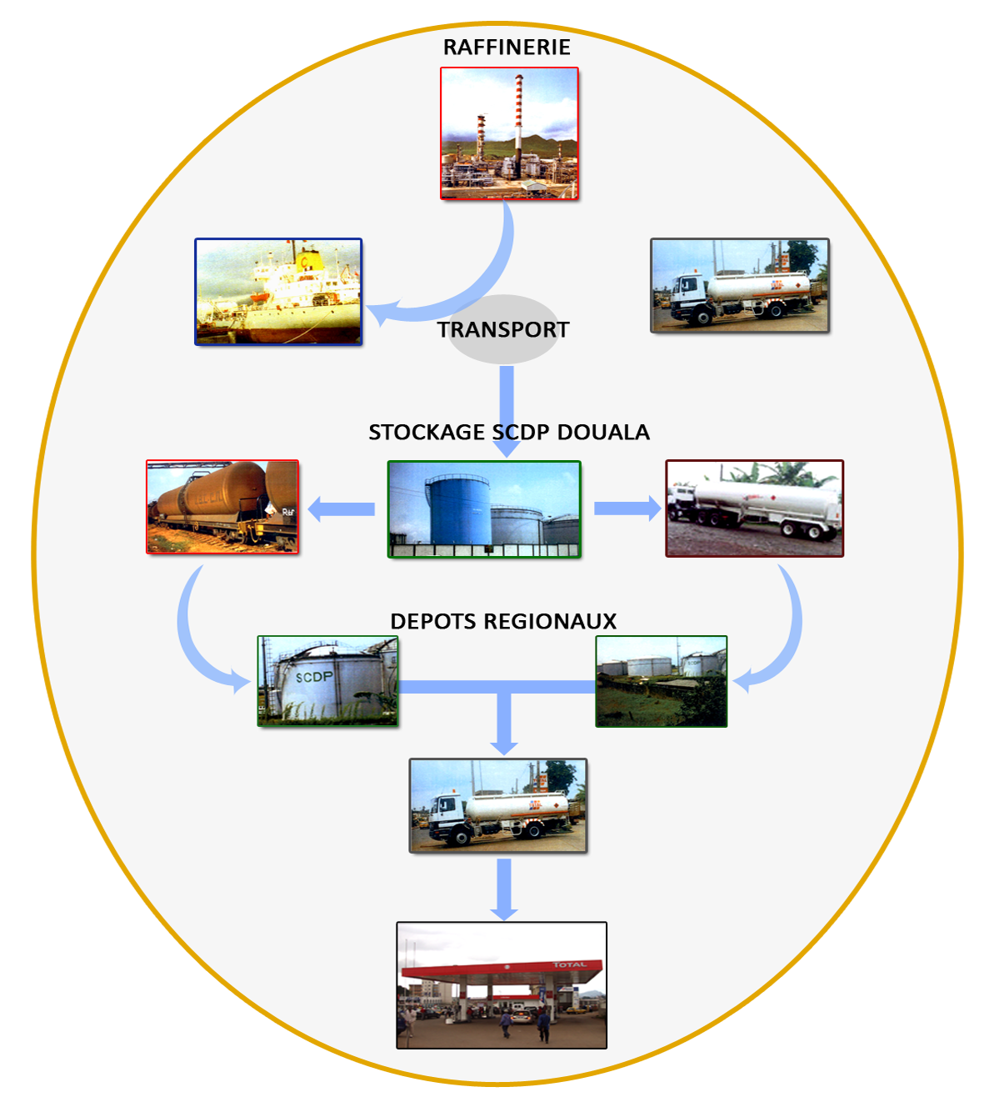
V- SUPPLY MECHANISMS OF THE DOMESTIC MARKET
WITH OIL AND GAS PRODUCTS
D- SUPPLY CHANNEL
(Continuation and end)

Slide 52
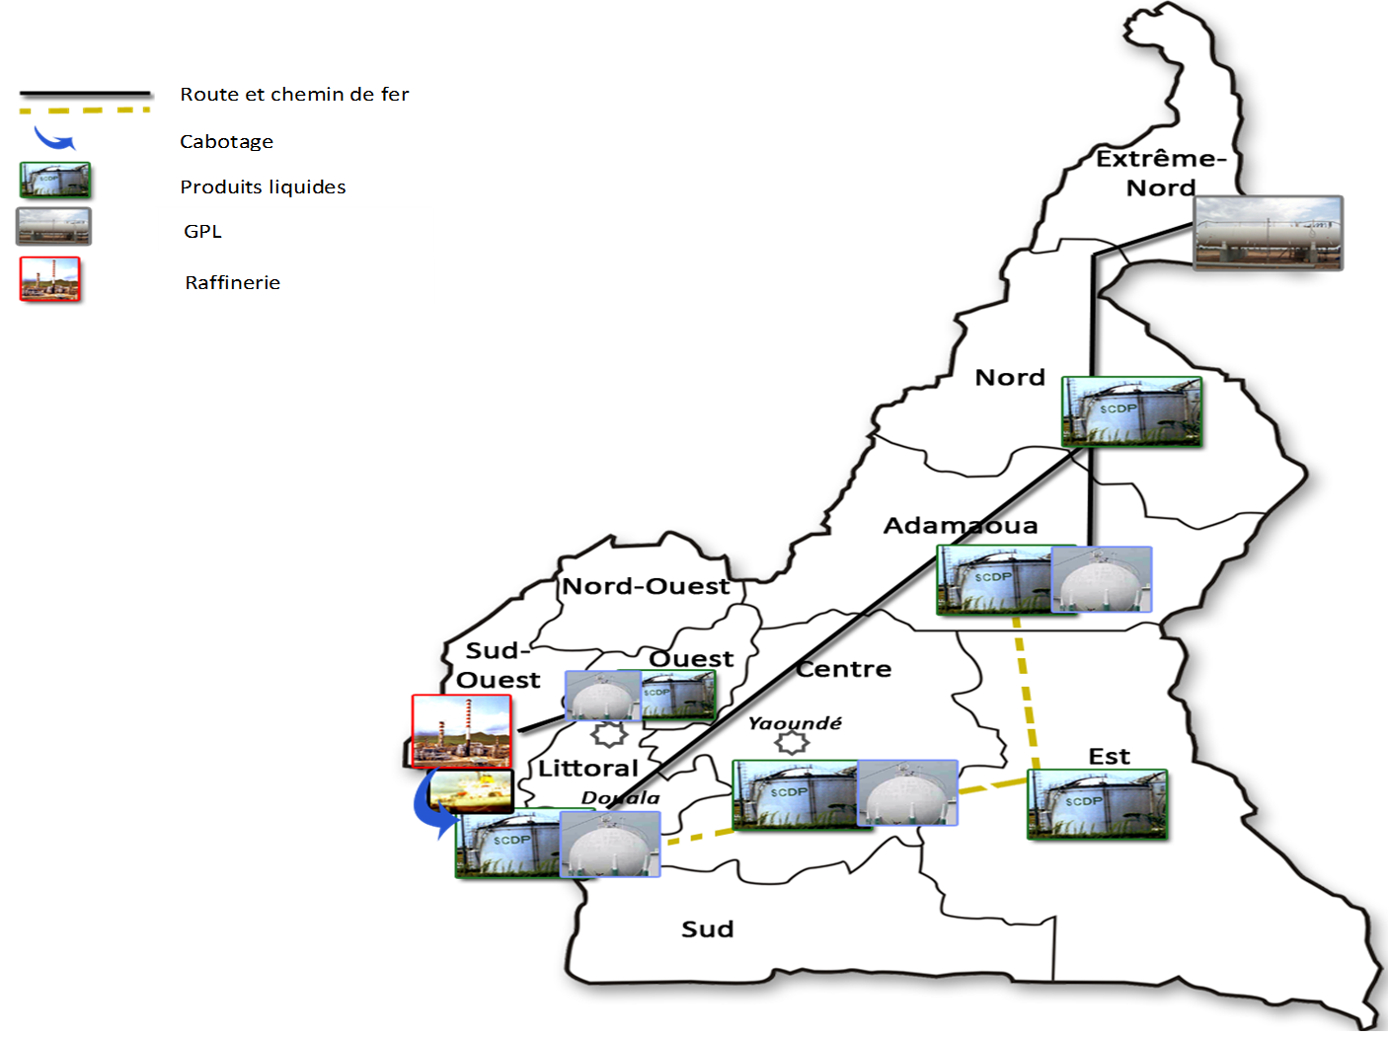
V- SUPPLY MECHANISMS OF THE DOMESTIC MARKET
WITH OIL AND GAS PRODUCTS
D- SUPPLY CHANNEL

Slide 53
V- SUPPLY MECHANISMS OF THE DOMESTIC MARKET
WITH OIL AND GAZ PRODUCTS
E- STORAGE OF OIL AND GAS PRODUCTS
1)Petroleum products
As of today, the storage of petroleum products is exclusively done by the SCDP. However, as far as the South-West Region is concerned, SONARA's storage capacities are used as a depot in Limbé.
There are 07 oil depots (Douala, Yaounde, Bafoussam, Ngaoundere, Belabo, Garoua and Limbe) and 02 filler centres (Maroua and Bertoua) built by the HPSF.
The HPSF is involved in the control of petroleum product storage policy by sitting in the SCDP's Board of Directors and gives its full support to this structure.

Slide 54
V- SUPPLY MECHANISMS OF THE DOMESTIC MARKET
WITH OIL AND GAZ PRODUCTS
E- STORAGE OF OIL AND GAS PRODUCTS
(Continuation and end)
2).Domestic gas
With regard to the LPG, in addition to the SCDP and SONARA which provide storage, private operators have moved into the sector and have their own filler centres.
These are:
SCTM ;
GREEN OIL;
BOCOM;
STARGAS ;
KOZAN CRISPLANT ;
INFOTECH ;
AZA AFRIGAZ ;
AKENO.

Slide 55
V- SUPPLY MECHANISMS OF THE DOMESTIC MARKET
WITH OIL AND GAZ PRODUCTS
F- TRANSPORTATION OF OIL AND GAS PRODUCTS
It is the transportation of large quantities of petroleum products from one point to another.
There is a pre-established conventional logistical itinerary for the delivery of petroleum products to the various SCDP depots, namely :
The Limbe-Douala coasting;
Railway (Douala -Yaounde, Belabo and Ngaoundere);
Road ( Limbe to Bafoussam and Douala to Garoua), from the depots to consumer outlets.
NB :
For transfers by rail, a Coordination and Monitoring of Transfer Operations Unit from the Douala depot to interior depots was set up by Decision no. 000192/2007/MINEE of 10 September 2007. However, with the Chad-Cameroon pipeline construction project, Camrail had prioritised the transport of pipes to the detriment of very constraining hydrocarbons, and stocks of petroleum products dropped drastically.

Slide 56
V- SUPPLY MECHANISMS OF THE DOMESTIC MARKET
WITH OIL AND GAZ PRODUCTS
F- STORAGE OF OIL AND GAS PRODUCTS
Also, to avoid shortages and market disruptions, MINEE created this Unit. Its role is to prepare a monthly transfer programme, the follow-up of logistical means and the implementation of actions likely to contribute to the security of the country's supply of petroleum products. This Unit also control road transfers from Limbe to Bafoussam and from Douala to Garoua.
In the event of failure of rail transport and/or in case of need, express transfer authorisations are issued by the HPSF to marketers for transfers by road so as to cover the shortfall.
This Unit is supervised by the HPSF

Slide 57
V- SUPPLY MECHANISMS OF THE DOMESTIC MARKET
WITH OIL AND GAZ PRODUCTS
G- DISTRIBUTION OF OIL PRODUCTS
This is the process of acquiring petroleum products from local refineries or by importing them, storing them in oil depots and returning them for the supply of consumption facilities, ships and aircraft.
The HPSF intervenes by ensuring healthy competition between distributors and by protecting consumers in monopoly areas.

Slide 58
V- SUPPLY MECHANISMS OF THE DOMESTIC MARKET
WITH OIL AND GAZ PRODUCTS
H- QUALITY CONTROL AND FIGHT AGAINST FRAUD
The quality control of petroleum products is carried out by HYDRAC on behalf of SONARA at the SCDP depot in Douala during deliveries by Cap Limboh and by HYDRAC or SGS for imports.
During transfers from the depots to the (SCDP) depots or from (SONARA) to the SCDP Bafoussam depot, the control is carried out jointly by the SCDP and HYDRAC agents before any unloading.
Finally, during service station deliveries, before unloading the products, the control is carried out by the personnel of those stations
A Committee for the Fight against Fraud in Oil Products,was created by decree no. 2002/2044/PM of 20 November 2002 modified and supplemented by decree no. 2009/1593/PM of 22 July 2009.

Slide 59
V- SUPPLY MECHANISMS OF THE DOMESTIC MARKET
WITH OIL AND GAZ PRODUCTS
H- QUALITY CONTROL AND FIGHT AGAINST FRAUD
(Continuation and end)
This Committee shall be responsible in particular for the fight against the illegal import, export, possession, denaturing, transport, sale and consumption of petroleum products.
It should be recalled that at its creation, this Committee was based at the Ministry of Finance and chaired by the Head of this Ministerial Department. Thanks to decree no. 2009/1593 of 22 July 2009, it was brought back to the Minister in charge of petroleum products.
Control operations in the field are carried out by the Oil Product Chemical Labelling Brigade, created by Decree no. 2010/3032/PM of 08 November 2010 and Crack Down Operations and Punctual Interventions by the MINEE's Mobile Intervention Brigade.

Slide 60
V- SUPPLY MECHANISMS OF THE DOMESTIC MARKET
WITH OIL AND GAZ PRODUCTS
I- ROLE OF REGIONAL SERVICES OF THE HPSF
To better monitor transfers and stocks of petroleum products, the General Manager of the HPSF created regional services in Bafoussam, Belabo and Ngaoundere.
Their missions are as follows:
The follow-up of authorised transfers by trucks;
the follow-up of the effectiveness of the consumption of lamp oil in accordance with circular no. 00062/CSPH/D of 23 January 2004;
The follow-up of LPG sales from private filler centres;
the follow-up of daily stocks of petroleum products.

Slide 61
SECTION VI:
VI- CHALLENGES AND PROSPECTS

Slide 62
VI- CHALLENGES AND PROSPECTS
A- Accessibility to oil and gas products
In order to bring petroleum products closer to low-income consumers or those living in localities far from depots, the HPSF should continue to build pilot service stations and filler centres.
To this end, the HPSF is planning to standardise the prices of petroleum products nationwide so as to re-establish social justice. The related feasibility studies are under completion by the BZ Consulting firm.

Slide 63
VI- CHALLENGES AND PROSPECTS
A- Accessibility to oil and gas products
It should be noted that the standardisation of prices currently applied is limited to localities with storage depots, whereas in localities located beyond a radius of 25 km around each depot, the said prices are subject to transportation costs from the depots to release for consumption facilities ( service stations and other consumer outlets).
As an example, the following gaps are
noted:
.

Slide 64
VI- CHALLENGES AND PROSPECTS
A- Accessibility to oil and gas products
Table 1: PRICE OF SUPER IN LOCALITIES FAR AWAY FROM DELIVERY DEPOTS (CFA F/LITRE)
DEPOTS | DEPOT PRICES | MOST REMOTE LOCALITY | LOCALITY PRICES | INCREASE | REMARKS
DOUALA | 630 | CAMPO | 660 | 30
YAOUNDE | 630 | DJOUM | 662 | 32
BELABO | 630 | Mouloundou | 702 | 72
NGAOUNDERE | 630 | NGAWI | 667 | 37
GAROUA | 630 | KOUSSERI | 684 | 54
LIMBE | 630 | MAMFE | 663 | 33
BAFOUSSAM | 630 | NKAMBE | 658 | 28
The work carried out by the BZ CONSULTING firm has enabled the preparation of simulations which established at 5 F CFA per litre, the financial impact of the rebalancing of the domestic prices of land fuels (super, lamp oil and gasoil) throughout the national territory, that is an overall amount of CFA F 8.4 billion for the first year of the implementation of the mechanism, all other things being equal.

Slide 65
VI- CHALLENGES AND PROSPECTS
A- Accessibility to oil and gas products
Three options were specifically considered to address the financial impact of the implementation related to the implementation of the price standardisation measure:
1) the cost to be borne by the State budget;
2) the cost to be borne by the HPSF from its own budget,
3) the cost to be born by consumers.
The standardisation at CFAF 5 /L will lead to the following reductions:
TABLE 2: DROP IN SUPER PRICES IN LOCALITIES MOST DISTANT FROM DELIVERY DEPOTS AFTER REBALANCING
DEPOTS | DEPOT PRICES | MOST REMOTE LOCALITY | LOCALITY PRICES | REVISED PRICES OF THE LOCALITIES | DROP
DOUALA | 635 | CAMPO | 660 | 635 | 25
YAOUNDE | 635 | DJOUM | 662 | 635 | 27
BELABO | 635 | Mouloundou | 702 | 635 | 67
NGAOUNDERE | 635 | NGAWI | 667 | 635 | 32
GAROUA | 635 | KOUSSERI | 684 | 635 | 46
LIMBE | 635 | MAMFE | 663 | 635 | 28
BAFOUSSAM | 635 | NKAMBE | 658 | 635 | 23

Slide 66
VI- CHALLENGES AND PROSPECTS
A- Accessibility to oil and gas products
Moreover, the standardisation of prices in Cameroon will enable:
on the socio-economic level ,to:
restore equity in access to energy;
boost domestic consumption and production of petroleum products, hence economic activity;
establish conditions conducive to the equitable development of decentralised local and regional collectivities;
improve the purchasing power of rural populations, but also their living conditions, particularly in the provision of drinking water and electricity supply by generators in health centres in remote areas.
On the political level, it will serve as a catalyst for the reconstruction of socio-economic infrastructures in the South-West and North-West regions.

Slide 67
VI- CHALLENGES AND PROSPECTS
B- STORAGE CAPACITY OF PETROLEUM PRODUCTS
Currently, there is a significant shortage of storage capacity for oil and gas products.
Over the next 10 years, the existing storage capacity of 240,000 m³ all products combined must be increased to 400,000 m³ so as to decongest the main warehouse in Douala, reduce demurrage expenses generated by the prolonged waiting time for import ships (boarding time) and guarantee the autonomy of regulatory stocks.
It is also important to build up LPG security stocks.

Slide 68
V- CHALLENGES AND PROSPECTS
C- Transport logistics
To ensure the safety of petroleum products transported by road and to fight against fraud during the transport of these products, the HPSF plans to geolocate tanker trucks.
Securing domestic gas cylinders to avoid handling at sales outlets also remains a challenge for the HPSF.
In order to better facilitate the supply of the domestic market with petroleum products, the construction of a pipeline linking the refinery and the SCDP depots in Douala and Yaounde would be a major contribution to reducing the cost of transportation of petroleum products.
Similarly, to optimise mass transfers to other interior depots by following the conventional logistical itinerary, in the short term, the acquisition of tank-wagons with most significant capacity, traction locomotives and tank trucks could be envisaged.

Slide 69
V- CHALLENGES AND PROSPECTS
D- Improvement of national production capacity
It is in the best interest of the HPSF for SONARA to be operational and for its production capacities to be improved. This would enable it to significantly reduce the costs involved in supporting the import of domestic gas.
To ensure energy independence from imports, the modernisation of SONARA through the installation of a hydrocracker to refine 100% of Cameroon's crude oil is very important.
The continuation of negotiations between the State of Cameroon represented by NHC and NEW AGE for the conclusion of a final contract for the supply of domestic gas from the Etinde block, covering an area of 2,316 km², in the South-West Region of Cameroon, would be a good breath of fresh air for the HPSF.

Slide 70
CONCLUSION

Slide 71
CONCLUSION
The mission of regulating the supplies of domestic market with petroleum and gas products gives the HPSF a strategic position in the downstream petroleum sector. The HPSF through this role, contributes to the economic stability of the country. Any lack of supply has a direct impact on the various sectors of the economy, in particular on the production and transport activities and on the prices of goods and services, especially basic necessities.

Slide 72
A TEAM SPIRIT,
ONE FAMILY

Slide 73
REPUBLIC OF CAMEROON
Peace - Work - Fatherland
---------------
RÉPUBLIQUE DU CAMEROUN
Paix - Travail - Patrie
---------------
THANK YOU FOR
YOUR KIND ATTENTION

